Slide 1
Supportive Supervision: Meaning, Rationale and Approach
USEEP TRAINING
People and Performance of Institutions
Theme 2

Slide 2
What is Supervision?
Supervision literally means “overseeing ”
Supervision means overseeing of a process, a worker or workers

Slide 3
Alfred Kadushin defines supervision as:
The responsibility of sustaining worker morale;
Helping the worker with job-related discouragements and discontents;
Giving workers a sense of:
  worth as professionals;
  belonging to the agency;
Security in their performance.
  What has been your experience with a supervisor?

Slide 4
What is a Supervisor?
Educate
Coach
Encourage
SUPERVISOR
Support
Lead by
Example
Discipline
Counsel

Slide 5
Who is a supervisor?
“A person who oversees a worker or workers in an organisation”
“A person who instructs, directs and controls workers in the performance of their duties”

Slide 6
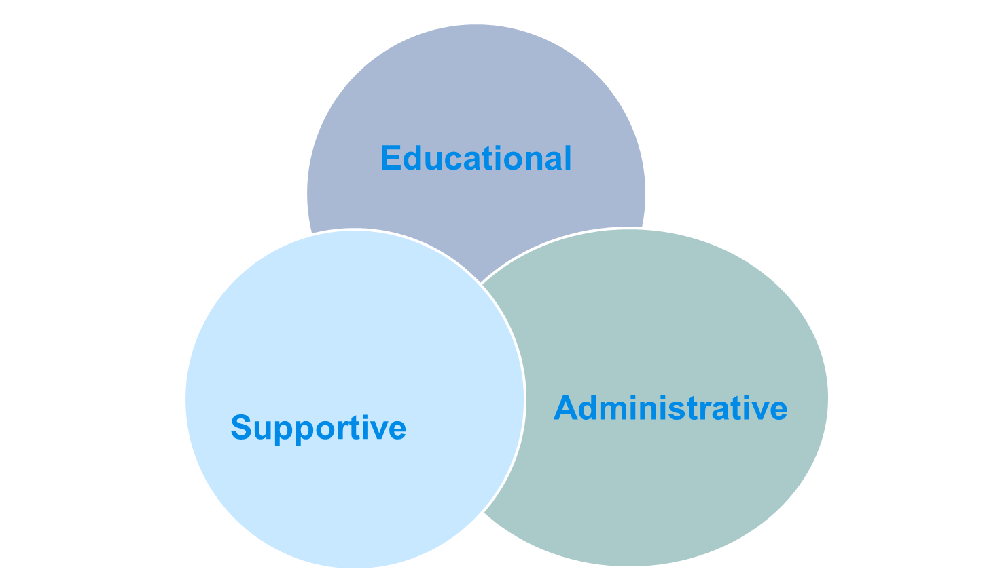
Supervisory Roles

Slide 7
Administrative Supervision
In administrative supervision, the supervisor acts as a manager and performs the following roles:
Recruiting and selecting staff
  But a secondary role
Inducting and placing the worker
  Supervisees need help to fit into the organisation
Planning work
Work assignment
Delegating work
Monitoring, reviewing, and evaluating work

Slide 8
Administrative Supervision-cont’d…
7. Coordinating work
Sharing information upwards, downwards, and laterally
Advocating change
Buffering change

Slide 9
Educational Supervision
In educational supervision, the supervisor acts as a teacher and facilitates learning
  Knowledge
  Skills
  Values
Applies learning theory
  Connects new to known
  Connects theory to practice
Transition from knowing to doing

Slide 10
Supportive Supervision
The supervisor acts as an adjustment counselor
Supervisees face a lot of job-related stress
Instrumental (or task-related) issues:
  Information
  Skills
  Structures
  Facilities

Slide 11
Supportive Supervision
Personal (people-centred) issues: emotional support
These issues are concerned with seeing that the people who do the job are comfortable, satisfied, and happy in their work and have a sense of psychological well-being:
  Recognition
  Reassurance
  Encouragement
  Approval
  Commendation
  Desensitization

Slide 12
Supportive supervision
Supportive supervision is a process of helping staff to improve their own work performance continuously.
It is carried out in a respectful and non-authoritarian way with a focus on using supervisory visits as an opportunity to improve knowledge and skills of health staff.
Supportive supervision is helping to make things work, rather than checking to see what is wrong.

Slide 13
Comparison between supervision approaches
Control approach (inspection) | Supportive supervision
Focus is on finding fault with individuals | Focus is on improving performance and building relationships
Supervisor is like a police man | Supervisor is more like a teacher coach, and mentor
Episodic problem-solving | Uses local data to monitor performance and solve problems
Little or no follow-up | Regular follow-up
Punitive action intended | Only support provided

Slide 14
Supportive supervision
During supportive supervision, the supervisor provides:
  Reassurance
  Encouragement
  Recognition for achievement
  Expressions of confidence
  Approval
  Attentive listening
  Stress and tension management strategies for the individual and unit as a whole

